Slide 1
L6 - Group 4
Alixander Roden
Ethan Ward-Taylor
Ionut Ciobanu

Slide 2
Mechanics
Three different items available to 4 players
Each item scores differently (some give more, some less)
Each item comes with pros and cons
Touching (bumping) into another player steals the item from them
There is no penalty for getting the item stolen from you

Slide 3
Mechanics: rewarding the players that do well
Able to drop the item whenever
If you reach the last 5 seconds, you get bonus points for holding the item
Drop the item right before 20s – highest bonus.
Hold the item over 20s – automatically drop the item and get a penalty; no extra
points

Slide 4






Mechanics
Low points
Normal points
High points
ITEMS
ROUNDS
Speed | FAST | NORMAL | SLOW
Physics | HIGH | NORMAL | LOW
Size

Slide 5
Example Round
Round 1
Slow Speed and score increases 5 points per second
Fast Speed and score increases 2 points per second
Round 2
No Gravity (Can move freely without jumping) and score increases 2 points per second
Low mass (Can jump high) and score increases 3 points per second
Round 3
Very small (Cant be seen on the map easily) and score increases 2 points per second
Very large (Cant move) and score increases 10 points per second
Normal Speed and score increases 1 point per second
High mass (Slow, cant jump .etc) and score increases 8 points per second
Final round all items are available to collect, and multiple items can be collected. For example a player could have no gravity, fast speed and be very small. The points would also combine so they would gain

Slide 6
Scoring
 |  |  | PHYSICS SPEED SIZE
150 pts. | 200 pts. | 250 pts. | 400 pts.
1ST ROUND
2nd ROUND
3rd ROUND
4th ROUND
SPEED
PHYSICS
SIZE

Slide 8
Psychographics
Achievers – achieving the goals of the game, looking for challenge
Killers – looking for competition, imposing themselves to others
Game Pleasures
Challenge – accomplishing tasks, solving puzzles
Discovery – looking for a clever strategy to win the game

Slide 9
Target Market
Semi hard-core to hard-core gamers, competitive players, people looking for a challenge or looking to show off their skills
Gender: Males
Age range: 15 - 35

Slide 10
Colour palette
Dark platforms and characters with colourful details
Colourful background based on the multiple shades of a single colour

Slide 11
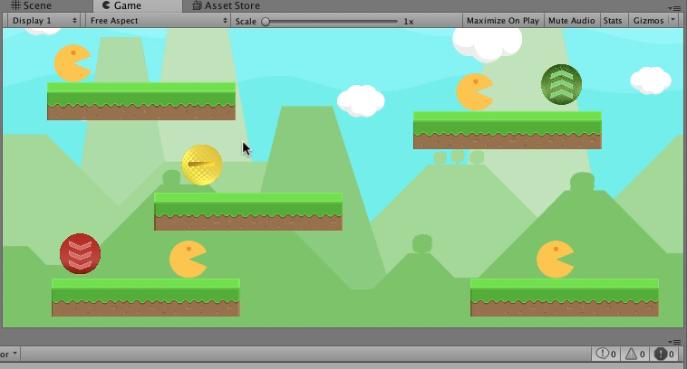
Unity Prototype

Slide 12
Development Timeline
Determine what types of items will feature in each round
Determine the scoring mechanics for each item
Creation of new prototype in Unreal Engine using the new mechanics
Test the new prototype and adjust the parameters of the icons
Add graphical assets to the prototype
Improve the prototype with the issues found during testing to create the MVP

Slide 13
Any Questions?

